Slide 1
Face MASK DEtector

Slide 2
Team Member
Jiale Liu (liu3jl@mail.uc.edu)
Advisor: Fred Annexstein

Slide 3
Goals
Based on the outbreak of the epidemic in early 2020 and the rapid spread of the new coronavirus, I hope that my program can be widely used and at the same time help more public places to improve supervision work, and help people around the world to jointly control the epidemic.

Slide 4
Intellectual Merits
Through our face mask detection program, you can upload your own photo to detect whether you are wearing a mask.

Slide 5
Broder Impacts
Now my project is just a detect program, If in the future it can be more perfected and used in some crowded public places for facial mask recognition, It will help us a lot in controlling the epidemic.

Slide 6
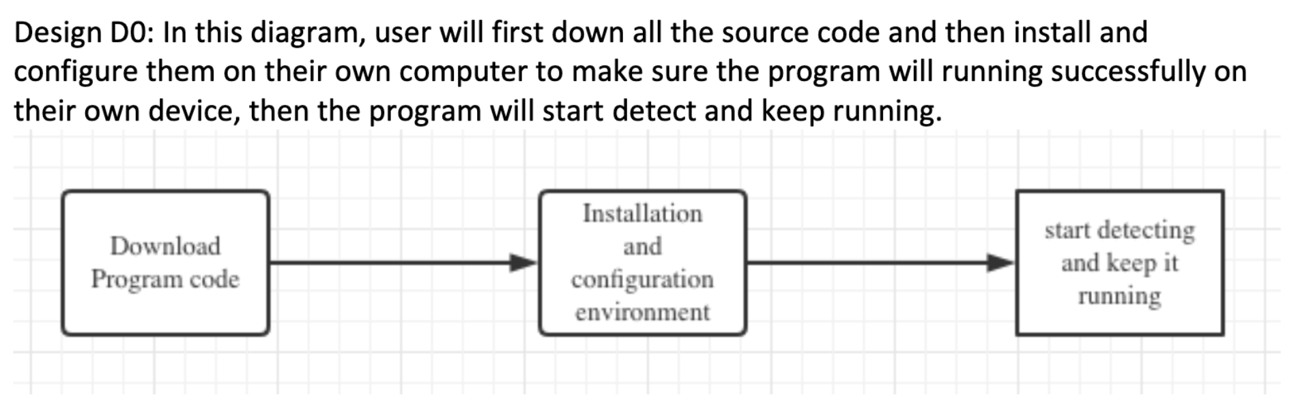
Design Specifications

Slide 7
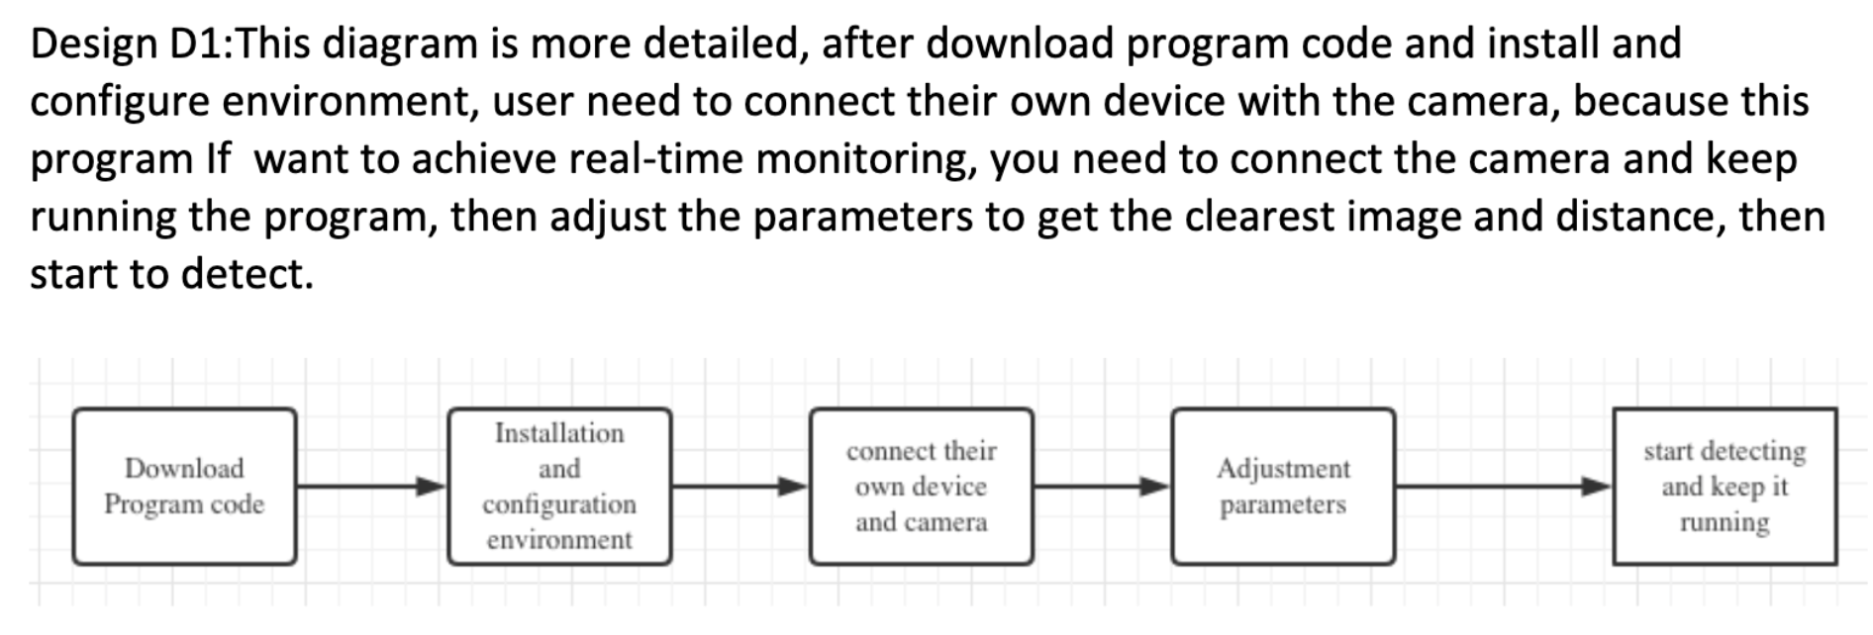

Slide 8
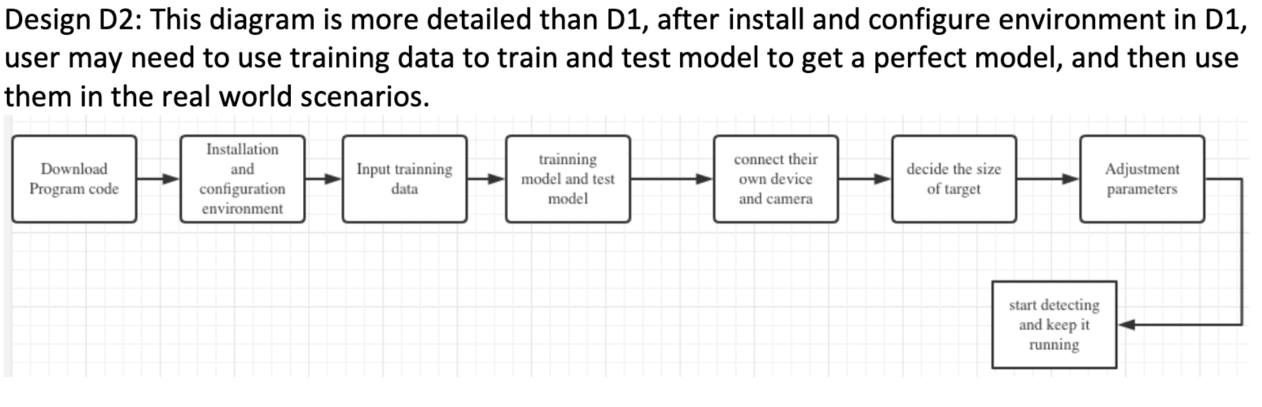

Slide 9
Technologies
In this project I used Tensorflow to apply MobileNetV2 network to train the model and predict the result then plot the training loss and accuracy.
Then I use OpenCV to read image and detect the object.
More information about technologies can browse my Github.

Slide 10
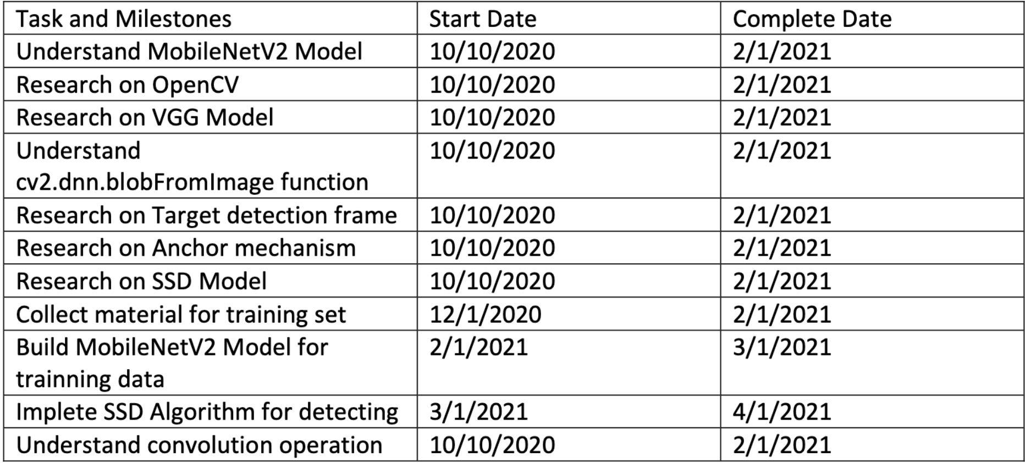
Milestones

Slide 11
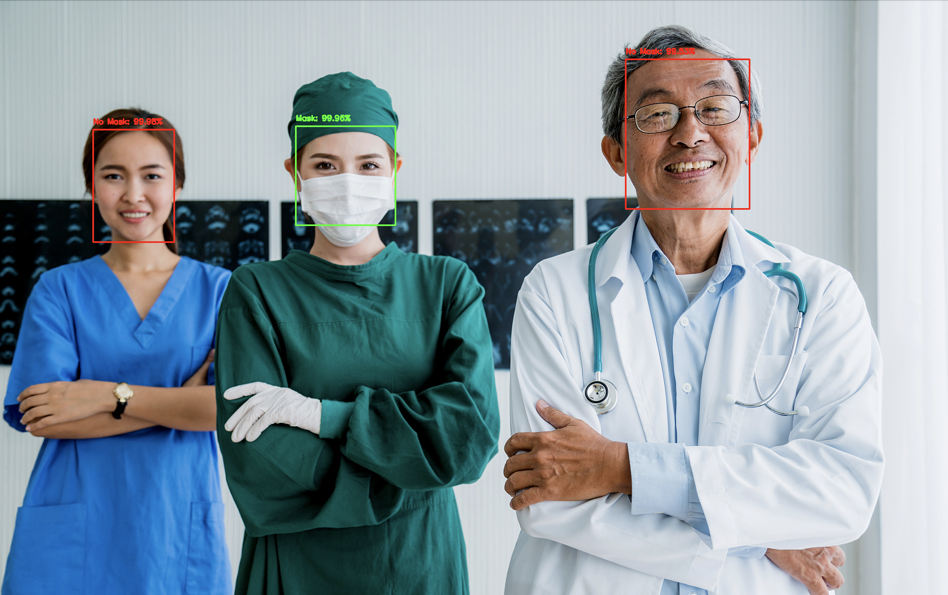
Results

Slide 12
Challenges
Deep Learning is really a profound area, Even if I spend a long time studying it, I can only apply it simply, but I can’t fully understand its principle. It requires you to have a high level of statistics and linear algebra, some of the technology I researched I didn’t apply on my progrom, because they are too difficult, so I cannot apply it on my project.

Slide 13
Thank you

